Slide 1

Communicate with each other…….

Slide 2


Slide 3
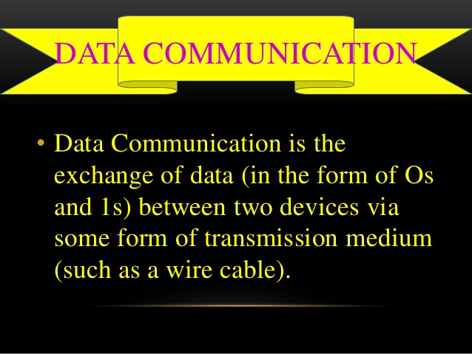

Slide 4
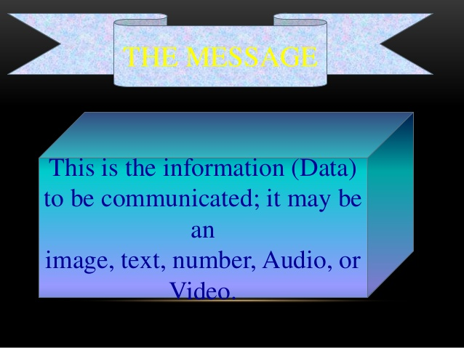
What should we say Data or Information?

Slide 5
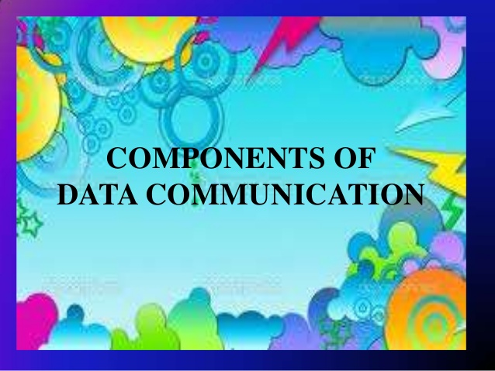

Slide 6
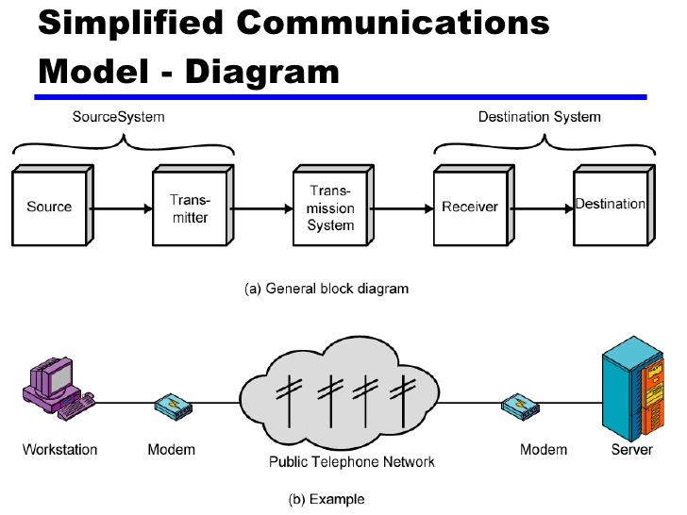

Slide 7


Slide 8
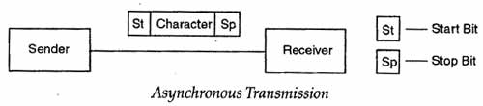
Character by character transmission

Slide 9
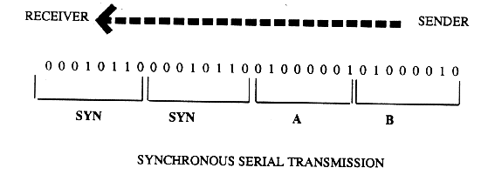
Block by block Transmission

Slide 10
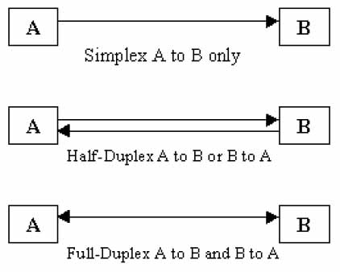
Data Transmission Mode

Slide 11

The End

